Slide 1
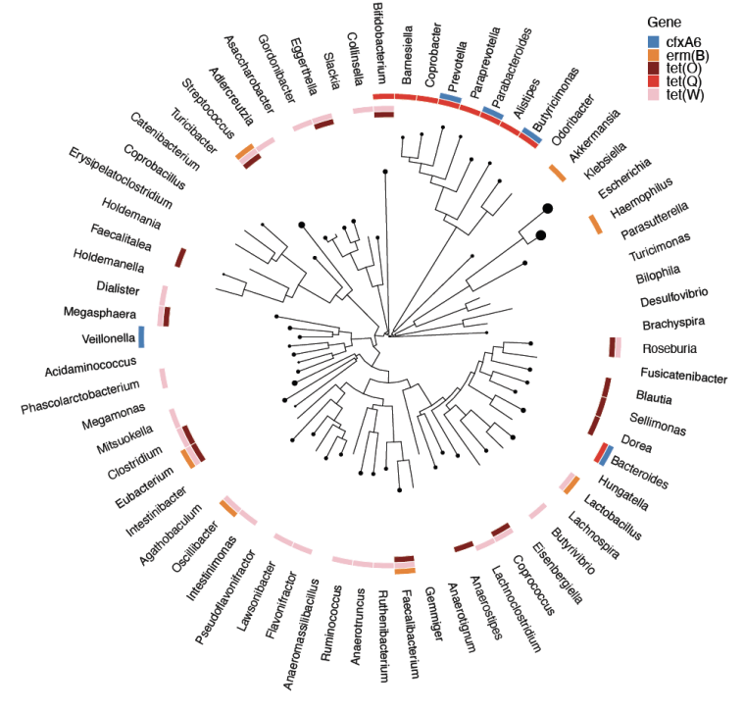

Bioconductor framework for multi-assay microbiome analysis
Leo Lahti
datascience.utu.fi | @antagomir
Department of Computing,
University of Turku, Finland

Slide 2
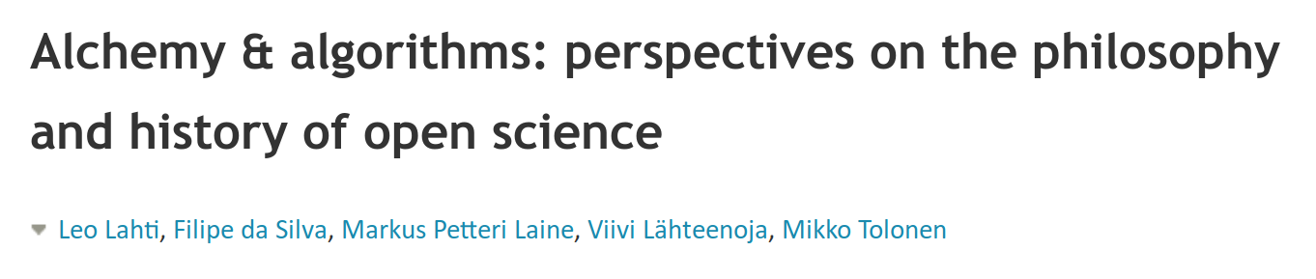
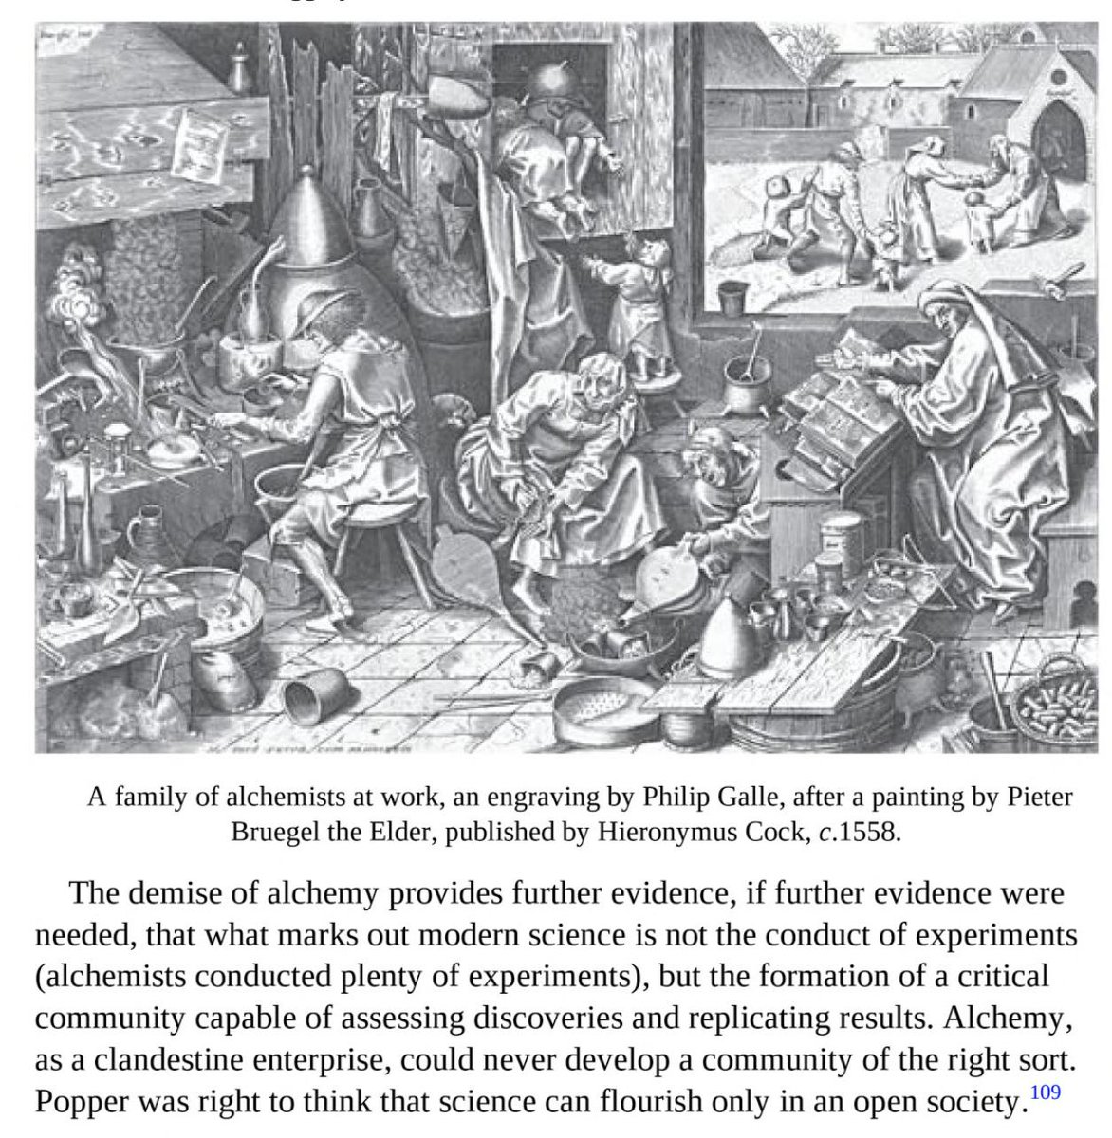
“What marks out modern science is not the conduct of experiments (alchemists conducted plenty of experiments), but the formation of a critical community capable of assessing discoveries and replicating results.” The Invention of Science: A New History of the Scientific Revolution, by David Wootton

Slide 3
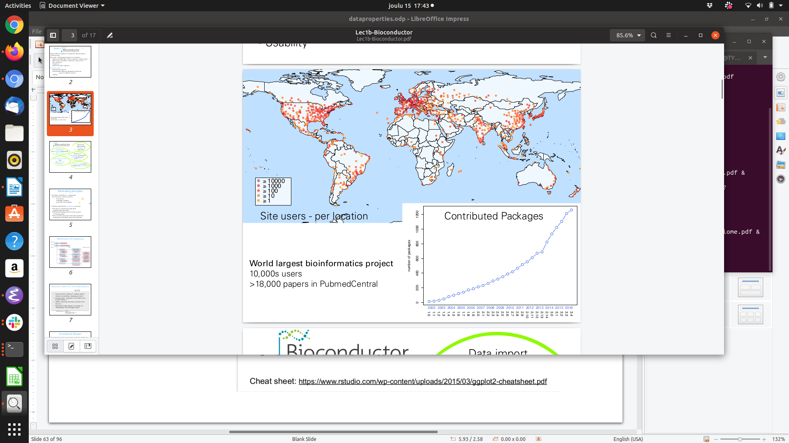

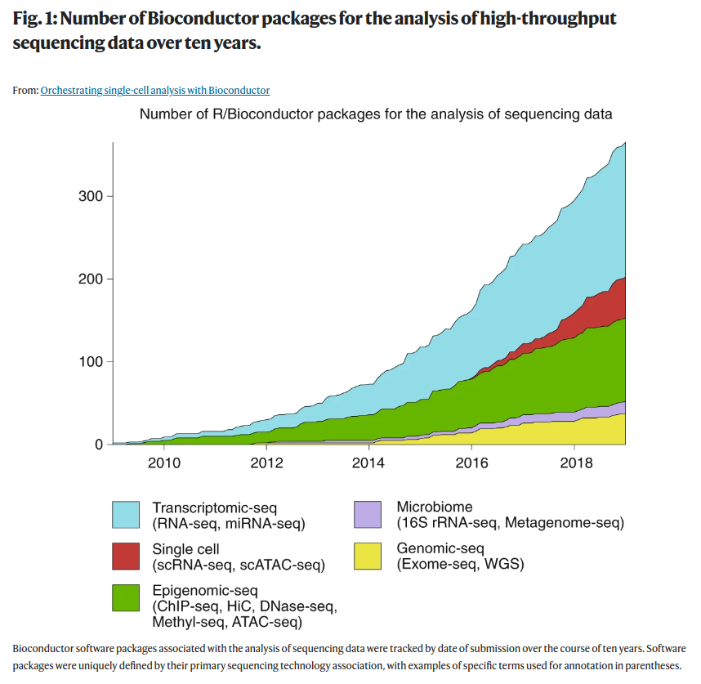
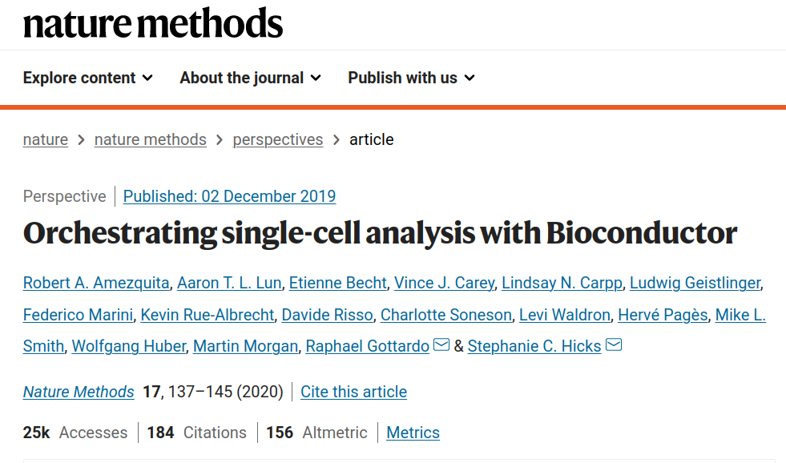
World’s largest bioinformatics project:
2300+ packages
Tens of thousands of users & publications
Multi-omics integration

Slide 4
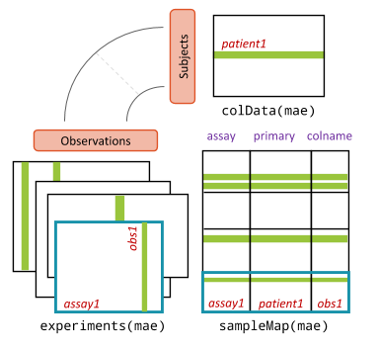
Data combinations increasingly large & heterogeneous
Increasing sample sizes, depth & untargeted assays
Spatio-temporal variation & resolution
Multi-pipeline (processing, pipelines, transformations)
Multi-level (hierarchies, phylogenies, nested designs)
Multi-assay (e.g. 16S + metagenome)
Multi-omic (taxonomic, functional)
Multi-kingdom (bacteriome, virome, mykobiome, eukaryome)
Multi-cohort (meta-analyses)

Slide 5
Data combinations increasingly large & heterogeneous
→ How to organize heterogeneous data sources? → How to build interoperable methods?
Increasing sample sizes, depth & untargeted assays
Spatio-temporal variation & resolution
Multi-pipeline (processing, pipelines, transformations)
Multi-level (hierarchies, phylogenies, nested designs)
Multi-assay (e.g. 16S + metagenome)
Multi-omic (taxonomic, functional)
Multi-kingdom (bacteriome, virome, mykobiome, eukaryome)
Multi-cohort (meta-analyses)

Slide 6
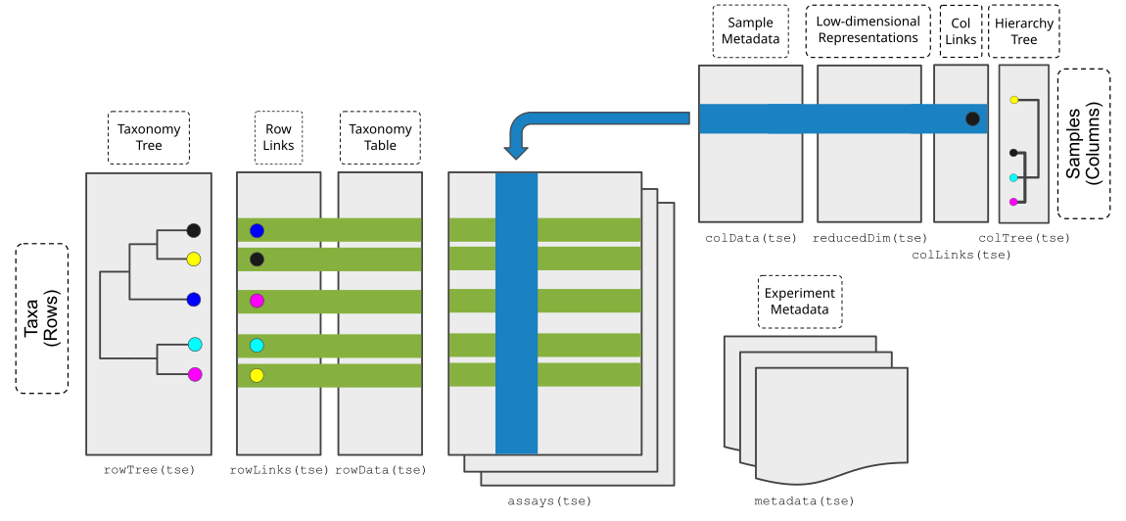
(Tree)SummarizedExperiment multi-assay data container
Commonly adopted data structures facilitate interoperability:
- (widely) shared methods & workflows
- more efficient & standardized analyses
Multiple assays
→ assays, altExp, reducedDim
Rich side information
→ sequences, metadata, rowData, colData
Hierarchies on sample & feature spaces
→ rowTree, colTree

Slide 7
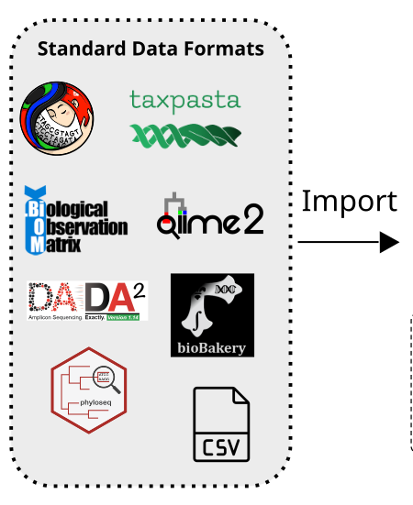
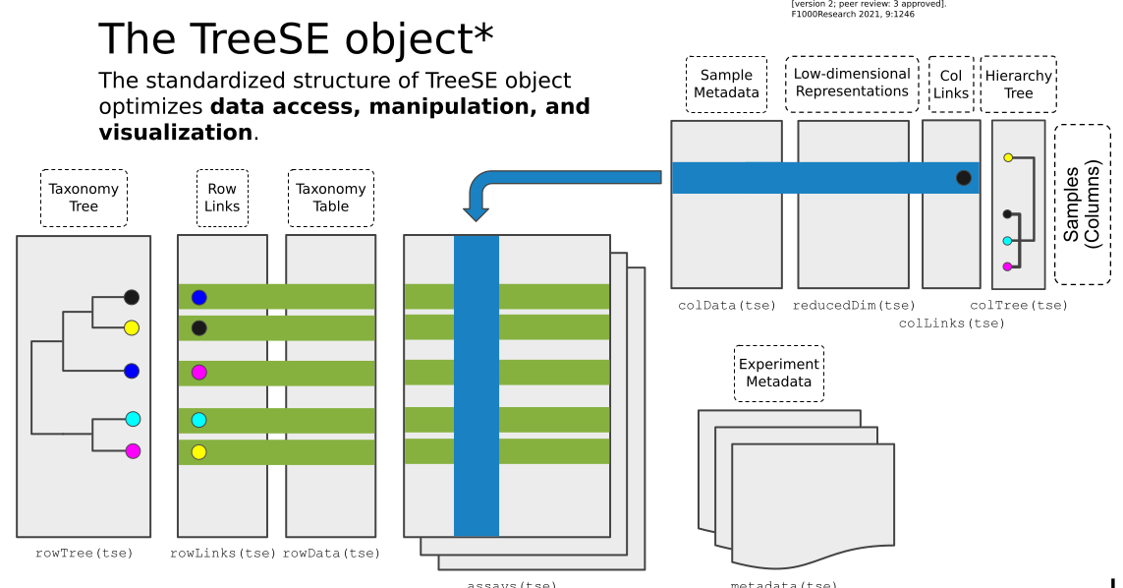
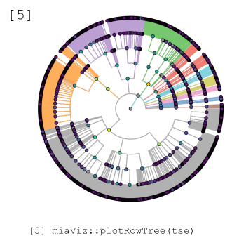
Microbiome data science workflow
Interoperable methods
Integrate
Wrangle &
Interact
Reproducible
reports
Import data
Tidy &
transform
Analyse &
visualize
Simulate
Model

Slide 8
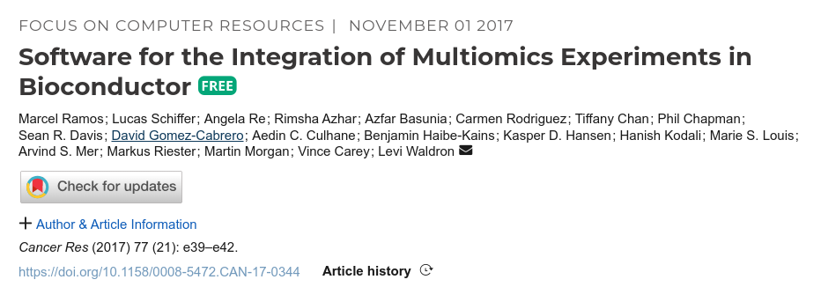
Dedicated data structures support multi-assay integration & analysis
(Tree)SummarizedExperiment
for individual omics
(Huang et al. 2021)
MultiAssayExperiment
for omics combinations
(Ramos et al. 2017)
Benefits:
- supporting rich data combinations
- used in multiple application domains
- community-driven

Slide 9



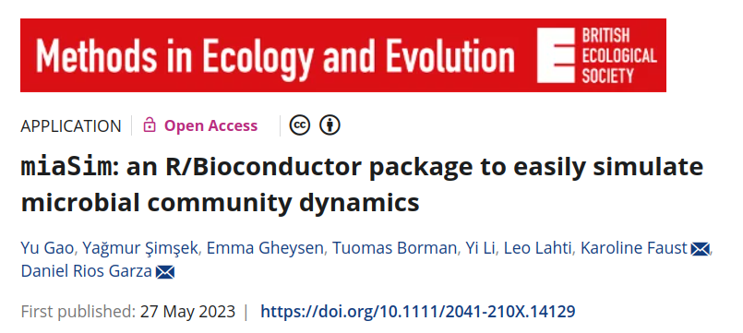
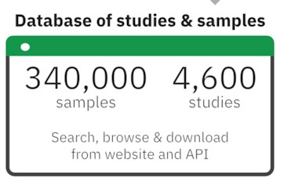

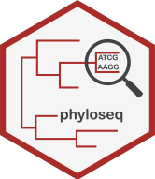


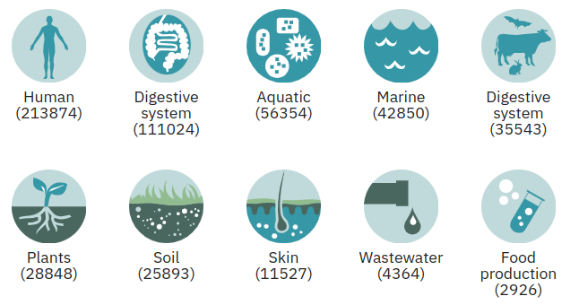
Easy import for key data formats & resources
Import common formats
Retrieve open data
EBI/MGnify, HoloFood, curatedMetagenomicData,ExperimentHub
Simulate microbiome dynamics miaSim
Import into optimized data containers facilitates downstream analyses

Slide 10
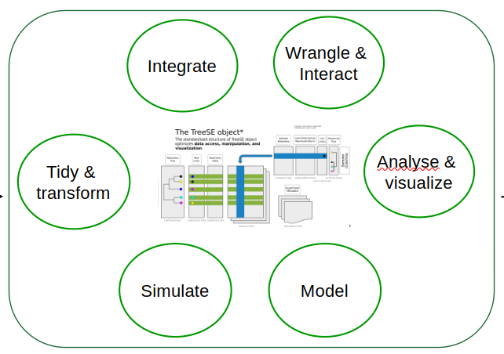
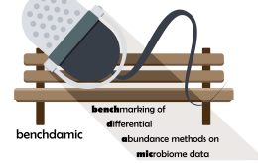
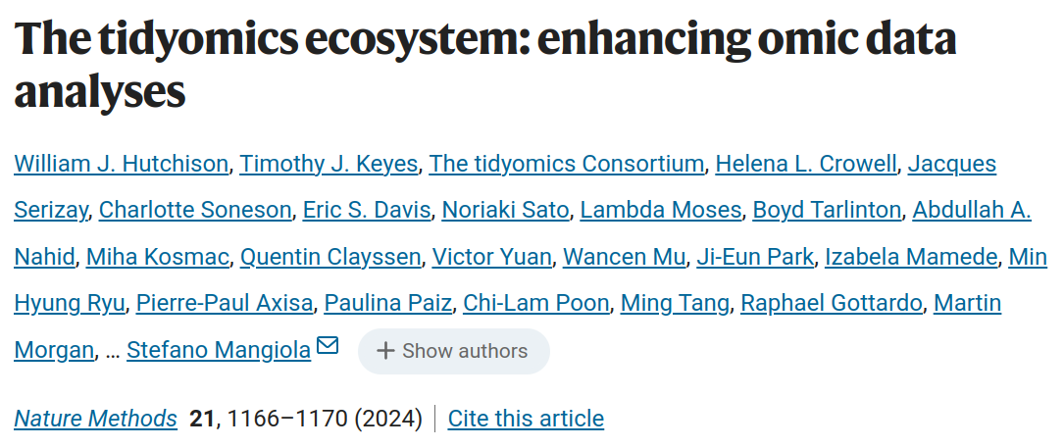
Package ecosystem
Custom methods for data import, wrangling, alpha & beta diversity, differential abundance, associations, enrichment, spatial and temporal data, simulation, visualization + interactive applications
Integration of taxonomic, metagenomic, functional, and multi-omic data
~20 packages dedicated to microbiome analysis
other application domains using similar data containers in R/Bioconductor: single cell, transcriptomics, proteomics, metabolomics
40,000k+ downloads in past 12 months; 500 issues & 1000 PRs closed
SummarizedExperiment is top-1% most downloaded package (14/2300) in Bioconductor

Slide 11

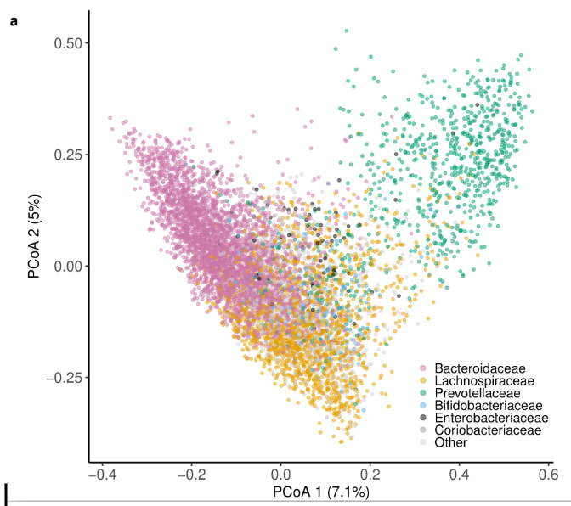
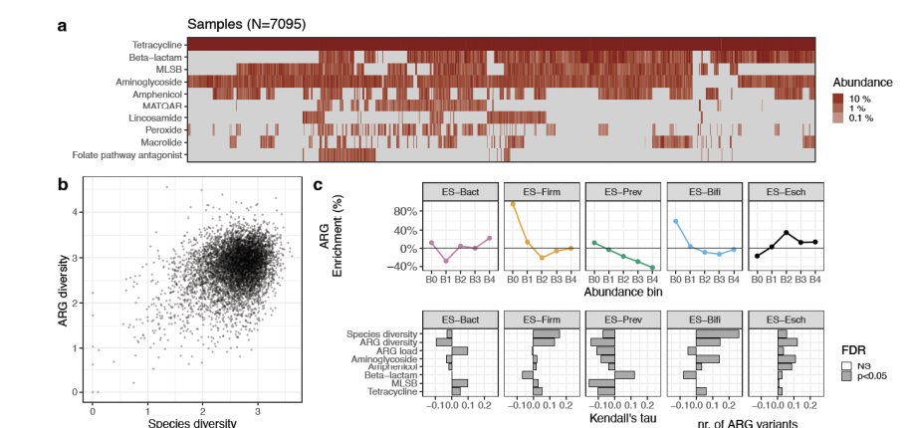
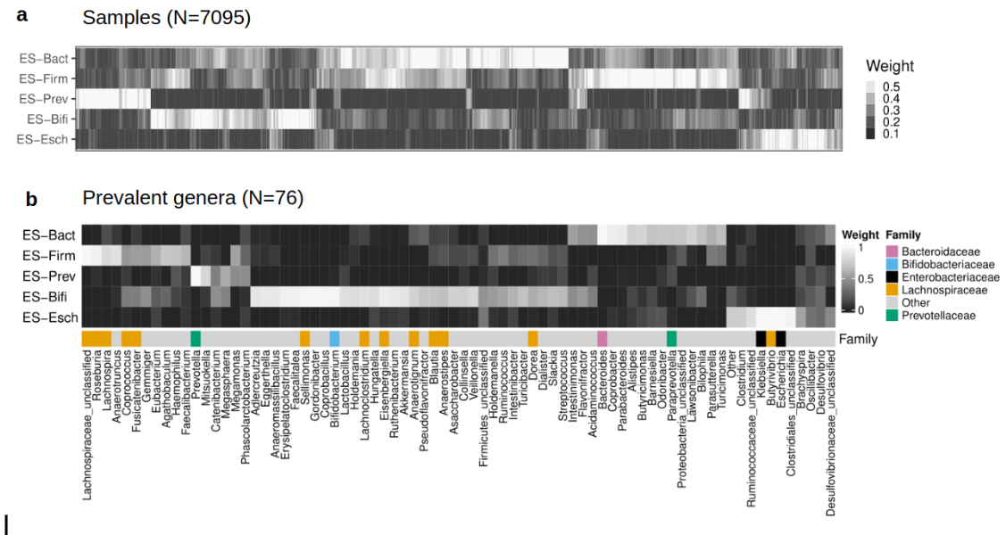
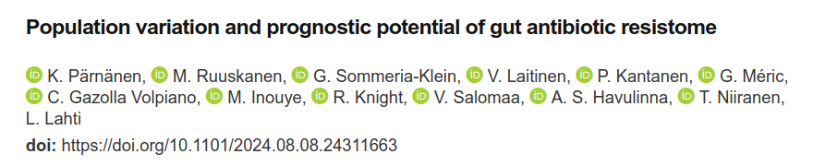
Online Gitbook (OMA) - beta version
Introduction to the new data science framework:
Downstream analysis of taxonomic, metagenomic, functional, multi-omic data
Statistical programming workflows
Multi-assay alternative to phyloseq
Online support & training workshops: Pune (IND) | Turku & Oulu (FIN) | Utrecht, Wageningen, Radboud (NLD) | Norwich (UK) | Bergen (NO), ECCB (FIN), EuroBioC (UK)
runMDS()
Enterosignatures vs. ARG load:
agglomerateByRank() → getNMF()
Bacterial phylogeny vs. resistance genes: plotFeatureLoadings()

Slide 12
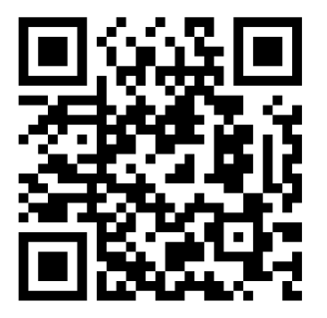
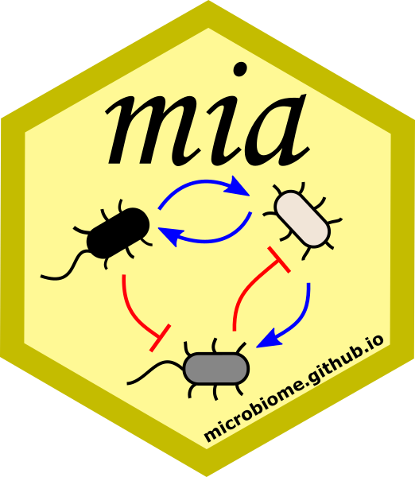







Thanks!
Coordination: Tuomas Borman & Leo Lahti
Department of Computing, University of Turku, Finland
40+ contributors from 10+ countries
Giulio Benedetti, Geraldson Muluh, Akewak Jeba, Basil Courbayre, Renuka Potbhare, Himmi Lindgren, Ely Seraidarian, Yağmur Şimşek, Théotime Pralas, Noah de Gunst, Axel Dagnaud, Sam Hillman, Matti Ruuskanen, Katariina Pärnänen, Pande Erawijantari, Aura Raulo, Mahkameh Salehi, Vilhelm Suksi, Kevin Gatel, Teo Dallier, Elliot Gaudron-Barry, Inès Benseddik, Shadman Ishraq, Jiya Chaudhary, Elina Chiesa, Shigdel Rajesh, Artur Sannikov, Henrik Eckermann, Lu Yang, Stefanie Peschel, Aaron Lun, Levi Waldron, Matteo Calgaro, Vivian Ikeh, Moritz Beber, Jacques Serizay, Karoline Faust, Daniel Garza, Yang Cao, Eineje Ameh, Sudarshan Shetty, Ruizhu Huang, Danielle Callan, Yu Gao, Ben Allen, Jesse Pasanen, Felix Ernst, Domenick Braccia, Héctor Corrada Bravo, Himel Mallick
Independent package developers: scater, scuttle, MicrobiotaProcess, phILR, ANCOMBC, ALDEx2, benchdamic, (Tree)SummarizedExperiment, SingleCellExperiment, MultiAssayExperiment, vegan, curatedMetagenomicData, ExperimentSubset, CBEA, microSTASIS
Poster: Tuomas Borman, Thursday 10am (#PS3.18.033)
microbiome.github.io

